Slide 1
AI-Systems Distributed Deep Learning (Part II) (294-162)
Amir Gholami & Joseph E. Gonzalez

Slide 2
Acknowledgments
Many slides from Shigang Li, Prof. Kurt Keutzer, Pallas Group

Slide 3
Agenda for Today
1:10-2:00: Preliminary Lecture on Parallel Training
2:00-2:45: PC Meeting Discussions
2:45-3:00: Break
3:00-4:00: Guest Lecture by MSFT DeepSpeed Team

Slide 4
Distributed Deep Learning

Slide 5
Objectives For Today
Challenges with Data Parallel Training
Model Parallelism
Pipeline Parallelism

Slide 6
Parallel and distributed training
Data parallelism
Pipeline parallelism
Model parallelism
Pros:
a. Make large model training feasible
b. No collective, only P2P
Cons:
a. Bubbles in pipeline
b. Removing bubbles leads to stale weights
Pros:
a. Make large model training feasible
Cons:
b. Communication for each operator (or each layer)
Pros:
a. Easy to realize
Cons:
a. Not work for large models
b. High allreduce overhead
Slide: Courtesy of Shigang Li

Slide 7


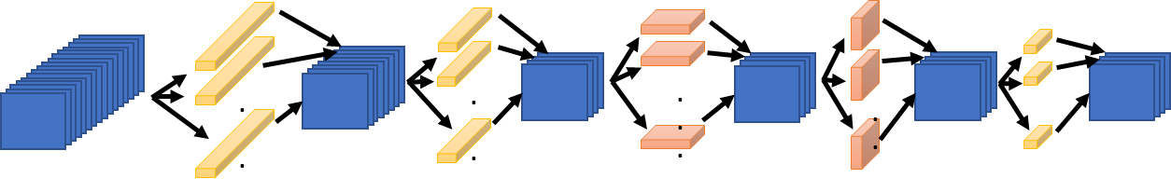
Synchronous Data Parallelism
1024
Compute the entire model on each processor
Distribute the batch evenly across each processor:
1024 batch distributed over 16 PEs: 64 images per GPU
Communicate gradient updates through allreduce
GPU 1
GPU 2
GPU 3
GPU 16
64
64
64
64
fprop
fprop
fprop
fprop
…
bprop
bprop
bprop
bprop
MPI ALLREDUCE

Slide 8
All Reduce
GPU 1
GPU 2
GPU 3
GPU 4
MPI ALLREDUCE
Notes:
a_1 = \sum_{i=1}^{B/4}\frac{\partial \mathcal{J}}{\partial w}
b_1 = \sum_{i=B/4}^{2B/4}\frac{\partial \mathcal{J}}{\partial w}
c_1 = \sum_{i=2B/4}^{3B/4}\frac{\partial \mathcal{J}}{\partial w}

Slide 9
Data Parallel Training Complexity Analysis
Question: Comm time of ring allreduce is independent of the number of processors. So what limits scalability?
GPU
GPU
GPU
…
GPU
Notes:
T_{{comm}}({batch}) = 2\sum_{i=0}^{L}\left(\alpha (P-1)+ \beta \frac{P-1}{P} |W_i| \right),

Slide 10
Limits of Data Parallel Scaling
The maximum limit of processors that you can use is P=B
But this often leads to very low utilization of the hardware and would not yield any speed up
Why?
Roofline model?
One epoch training time of AlexNet computed on an Intel KNL system

Slide 11
Limits of Data Parallel Scaling
The maximum limit of processors that you can use is P=B
But this often leads to very low utilization of the hardware and would not yield any speed up
One epoch training time of AlexNet computed on an Intel KNL system

Slide 12
Scaling Data Parallel Training
1024
If we want to keep scaling synchronous SGD then we have to keep increasing the batch size.
GPU 1
GPU 2
GPU 3
GPU 16
64
64
64
64
fprop
fprop
fprop
fprop
…
bprop
bprop
bprop
bprop
MPI ALLREDUCE

Slide 13
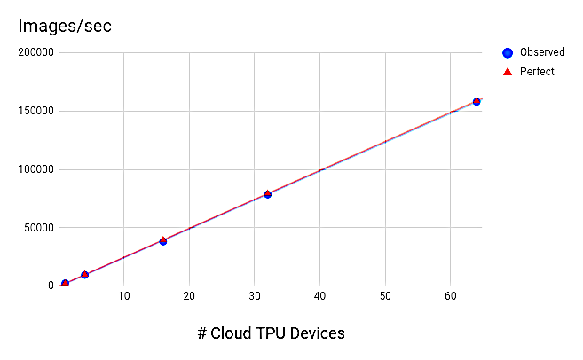
Naively increasing Batch size leads to perfect results but …

Slide 14
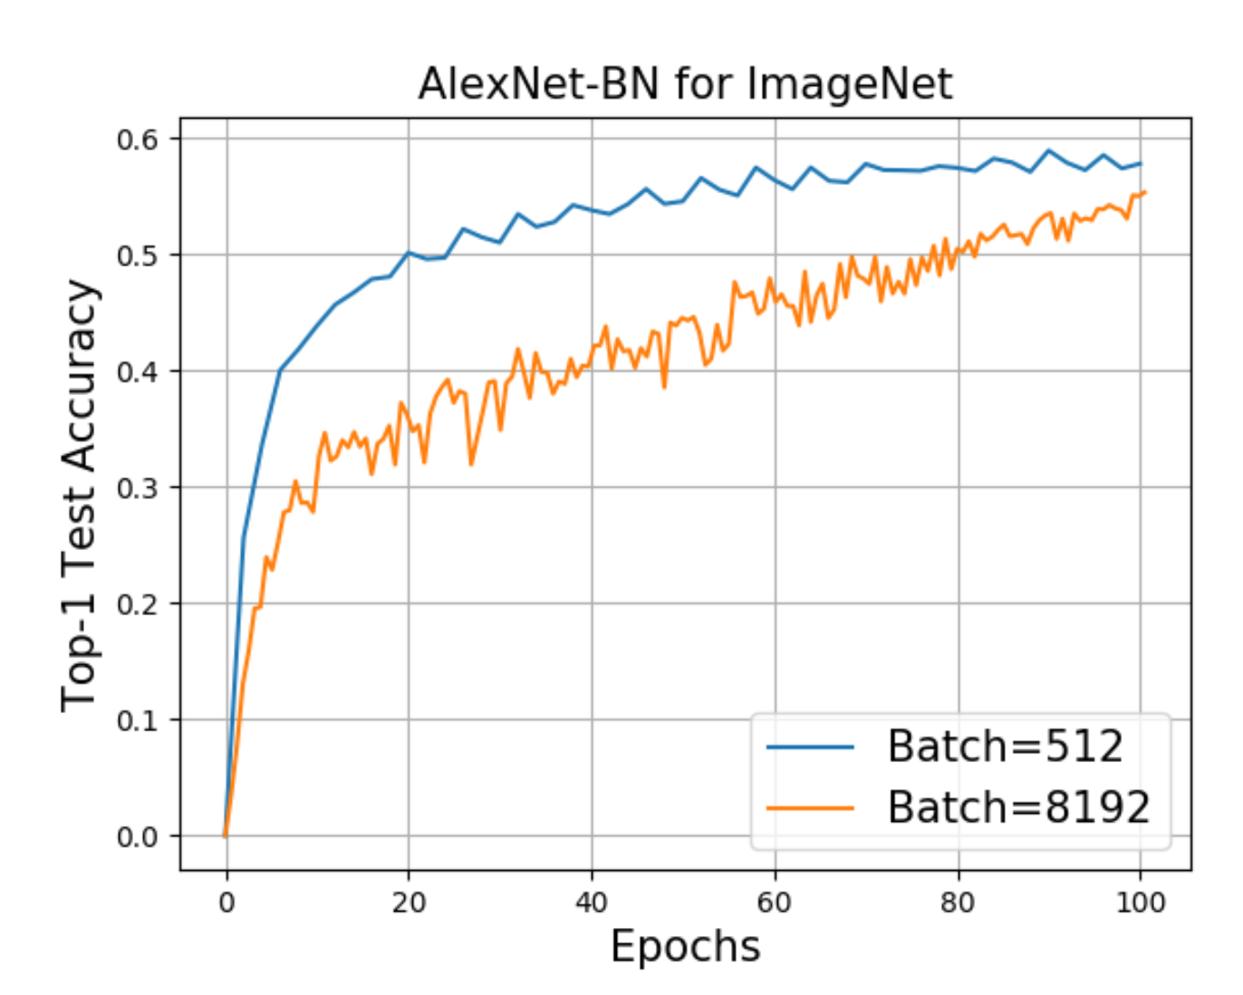
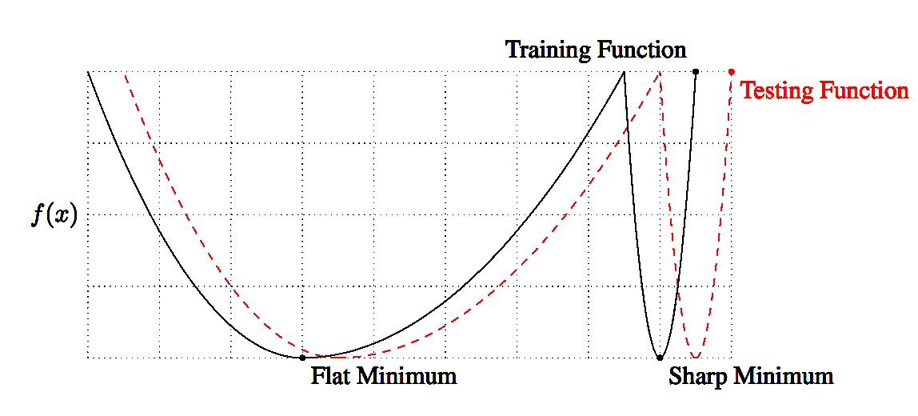
Problems with Large Batch Training
Larger Batch leads to sub-optimal generalization
A common belief is that large batch training gets attracted to “sharp minimas”
Keskar et al., On Large-Batch Training for Deep Learning: Generalization Gap and Sharp Minima, ICLR’16.
Z. Yao, A. Gholami, Q. Lei, K. Keutzer, M. Mahoney. Hessian-based Analysis of Large Batch Training and Robustness to Adversaries, NeurIPS’18.
Ginsburg, Boris, Igor Gitman, and Yang You. "Large Batch Training of Convolutional Networks with LARS." arXiv:1708.03888, 2018.

Slide 15
Generalization Gap Problem
Larger batch sizes harm generalization performance.
Goyal, Priya, et al. "Accurate, large minibatch SGD: Training imagenet in 1 hour." arXiv preprint arXiv:1706.02677 (2017).

Slide 16
Bigger isn’t Always Better
Motivation for larger batch sizes
More opportunities for parallelism → but is it useful?
Recall (1/n variance reduction):
Is a variance reduction helpful?
Does it affect the final prediction accuracy?

Slide 17
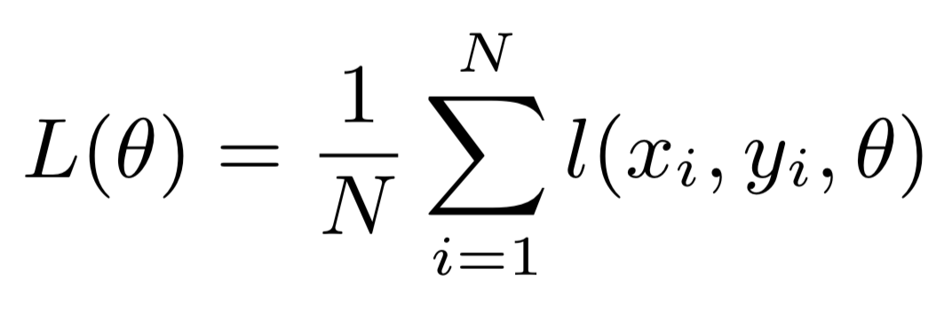
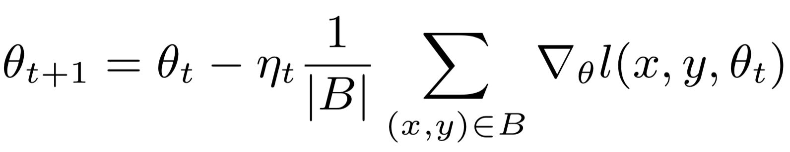
Why? Large Batch Reduces Noise and may Get Trapped in Local Minima
Objective function
Update rule
Small batch gradient descent acts as a regularizer
Loss
Sharp Minima Hypothesis
Parameter values along some direction
Active Research problem: Addressing the generalization gap for large batch sizes.

Slide 18
Solution: Linear Scaling Rule
Scale the learning rate linearly with the batch size
Addresses generalization performance by taking larger steps (also improves training convergence)
Sub-problem: Large learning rates can be destabilizing in the beginning.
Gradual warmup solution: increase learning rate scaling from constant to linear in first few epochs
Doesn’t help for very large k…

Slide 19
Key Results
Batch Size
Learning Rate
All curves closely match using the linear scaling rule.
Note learning rate schedule drops.
Goyal, Priya, et al. "Accurate, large minibatch SGD: Training imagenet in 1 hour." arXiv preprint arXiv:1706.02677 (2017).

Slide 20
Key Results
8 P100 GPUs
352 P100 GPUs
“Learning” Epoch
Epoch
Second
Machine Learning
System

Slide 21
Key Results
Train ResNet-50 to state-of-the-art on 256 GPUs in 1 hour
90% scaling efficiency
Fairly careful study of the linear scaling rule
Observed limits to linear scaling do not depend on dataset size
But what is the limit?
You cannot indefinitely scale the learning rate …
Since then there has been a race to train ImageNet faster and several new large batch training methods have been developed (some with good foundation and some heuristics)

Slide 22

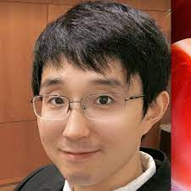


ImageNet Training Competition!
ImageNet is a dataset of 1.2M 224x224 images
Training 720 hours → <1 minute
200,000x Speedup in 10 years
Latest record:
14 seconds on TPUv4-6912
(as of Feb 2022)
Iandola
Yang You
Iandola FN, Moskewicz MW, Ashraf K, Keutzer K. FireCaffe: near-linear acceleration of deep neural network training on compute clusters. In Proceedings of the IEEE Conference on Computer Vision and Pattern Recognition 2016 (pp. 2592-2600).
You Y, Zhang Z, Hsieh CJ, Demmel J, Keutzer K. Imagenet training in minutes. In Proceedings of the 47th International Conference on Parallel Processing 2018 Aug 13 (p. 1) ACM (Best Paper Award)

Slide 23
Very active area of research
Large batch training is very brittle and often requires a lot of tuning to the point that it is often not worth the extra compute. Solving this is still an open research area:
Golmant, Noah, et al. "On the computational inefficiency of large batch sizes for stochastic gradient descent” (Cal)
Shallue et al. “Measuring the Effects of Data Parallelism on Neural Network Training” (Google)
You, Yang, et al. "Large batch optimization for deep learning: Training BERT in 76 minutes." (Cal)

Slide 24
Data Parallelism Summary
An efficient parallel training method where the comm time is independent of processors with ring allreduce
Very easy to implement. Only requires allreduce operation before updating parameters
Very challenging to scale. Using large batch training is not an option as it hurts generalization performance.
Existing solutions often require a lot of tuning (outside of ResNet-50 on ImageNet)
Does not work for large models such as GPT-3 which are too large to fit in one GPU
Processes are never idle

Slide 25
Pipeline Parallelism
Really a form of model parallelism

Slide 26
Parallel and distributed training
Data parallelism
Pipeline parallelism
Model parallelism
Pros:
a. Make large model training feasible
b. No collective, only P2P
Cons:
a. Bubbles in pipeline
b. Removing bubbles leads to stale weights
Pros:
a. Make large model training feasible
Cons:
b. Communication for each operator (or each layer)
Pros:
a. Easy to realize
Cons:
a. Not work for large models
b. High allreduce overhead
Slide: Courtesy of Shigang Li

Slide 27
Pipeline Parallelism
Bubble where processes are idle
Time

Slide 28
GPipe [NeurIPS’19]: Reduce Bubble with Micro-Batching
proportional to N
GPipe reduces the bubble size by breaking the batch size into smaller pieces to reduce the idle time of the processes
Pro: Reduces bubble size in an easy to implement manner
Con: Significantly increases activation memory
Slide: Courtesy of Shigang Li

Slide 29
PipeDream[SOSP’19]: Use Async Updates to remove Bubble
Pipedream uses asynchronous training: Avoid any idling by always doing a forward/backward pass irrespective of stale gradients/weights
Pro: No bubble
Con: As with other async methods this does affect model accuracy and convergence, and as such has not been adopted in industry.
Slide: Courtesy of Shigang Li

Slide 30
Asynchronous Methods
General advice: Training methods that adversely affect generalization are not adopted, unless there is a 10x speed improvement.
Otherwise, there are so many moving parts that can go wrong in training NNs, that most often practitioners stay away from async methods unless absolutely necessary
For example training very large rec systems.

Slide 31
Chimera: Bidirectional Pipeline
Big idea: Replicate the model to the other processes so that we can do forward pass in two directions
Slide: Courtesy of Shigang Li

Slide 32
Gradient Synchronization
Slide: Courtesy of Shigang Li

Slide 33
Summary
Slide: Courtesy of Shigang Li

Slide 34
Pipeline Parallelism Summary
Slightly more involved algorithm than data parallel method but with the advantage of only requiring point to point communication
Ideal for large scale training to thousands of processes where point-to-point communication is much cheaper than collective operations such as allreduce or all-gather
Requires special handling of bubble that results in idle processes

Slide 35
Model Parallelism
AKA Operator Parallelism

Slide 36
Model Parallelism
Divide the model across machines and replicate the data.
Supports large models and activations
Requires communication within single evaluation
How to best divide a model?
Split individual layers
which dimension?
Weights or spatial → depends on operation
Split across layers
Only one set of layers active a time → poor work balance
Soln: Pipelining Parallelism

Slide 37
Model Parallelism: Weights
It helps to think of the operations in matrix form. Consider an FC layer
Data Parallelism: Partition input across different Processors (batch dimension)
Model Parallelism: Partition weights across different Processes (W dimension)
Let’s discuss the communication details, step by step
Notes:
\begin{align*}
T_{{comm}}({domain}) = &\sum_{i=1}^{L}\left(\alpha {\log(P)}+ \beta \frac{P-1}{P} d_i\right)\\
+2&\sum_{i=2}^{L}\left(\alpha {\log(P)}+ \beta \frac{P-1}{P} d_{i-1}\right)
\end{align*}

Slide 38
Model Parallelism: Forward Pass
d_{i}
B
B
P₀
P₀
P₁
P₀
P₀
P₁
d_{i}/P
d_{i}/P
*
d_{i}
P₁
P₁
W
X
Y^{local}
Y
Requires an all gather communication so that all processes get each others activation data
Same cost as all reduce without the 2x factor
Notes:
\begin{align*}
\sum_{i=1}^{L} \beta (P-1) \frac{Bd_i}{P}\right)
\end{align*}
\begin{align*}
T_{{comm}}({domain}) = &\sum_{i=1}^{L}\left(\alpha {\log(P)}+ \beta \frac{P-1}{P} Bd_i\right)\\
+2&\sum_{i=2}^{L}\left(\alpha {\log(P)}+ \beta \frac{P-1}{P} d_{i-1}\right)
\end{align*}

Slide 39
Model Parallelism: Backward Pass
P₀
P₁
P_{0,} P₁
P₀
d_{i}/P
*
P₁
X^{T}
∇_{Y}
∇_{W}
No communication needed as every processor only needs the gradient of its own parameters
Notes:
\begin{align*}
\sum_{i=1}^{L} \beta (P-1) \frac{Bd_i}{P}\right)
\end{align*}
\begin{align*}
T_{{comm}}({domain}) = &\sum_{i=1}^{L}\left(\alpha {\log(P)}+ \beta \frac{P-1}{P} Bd_i\right)\\
+2&\sum_{i=2}^{L}\left(\alpha {\log(P)}+ \beta \frac{P-1}{P} d_{i-1}\right)
\end{align*}

Slide 40
Backward Pass
P₀
d_{i}
B
P₀
P₁
P₀
P₁
P₀
P₁
d_{i}/P
*
d_{i}
P₁
W^{T}
∇_{Y}
∇_{X}
∇_{X} ^{local}
Aggregating input gradient requires an allreduce operation
Notes:
\begin{align*}
2\sum_{i=2}^{L}\left(\beta (P-1) \frac{Bd_i}{P}\right)
\end{align*}

Slide 41
Communication Complexity Analysis
In Model Parallelism we need two forms of communication:
All Gather operation so that all processors get all the activations
All reduce operation for backpropagating activation gradients
All Gather
All Reduce
Notes:
\begin{align*}
\sum_{i=1}^{L}\left(\beta (P-1) \frac{Bd_i}{P}\right) + 2\sum_{i=2}^{L}\left(\beta (P-1) \frac{Bd_i}{P}\right)
\end{align*}

Slide 42
Model vs Data Parallelism?
When does it make sense to use Model vs Data Parallelism?
Model parallelism reduces the quadratic comm on d_{i}
It is useful for layers with very large weights d_{i} >> 1
It makes sense to use an integrated/hybrid data and model parallelism
Gholami, Amir, Ariful Azad, Peter Jin, Kurt Keutzer, and Aydin Buluc. "Integrated model, batch, and domain parallelism in training neural networks." SPAA, 2018.
Notes:
\begin{align*}
\sum_{i=1}^{L}\left(\beta (P-1) \frac{Bd_i}{P}\right) + 2\sum_{i=2}^{L}\left(\beta (P-1) \frac{Bd_i}{P}\right)
\end{align*}
\begin{align*}
T_{{comm}}({data}) = \sum_{i=1}^{L}\left(\beta (P-1) \frac{d_i^2}{P}\right)
\end{align*}

Slide 43
Model Parallelism Summary
More optimal comm time for large FC layers than Data parallel approach
Makes training large models feasible by breaking it into smaller parts
However, requires blocking collective communication during both forward pass (all gather), as well as backwards pass (all reduce)
Slightly harder to implement than data parallel
Processes are never idle

Slide 44
Spatial Parallelism

Slide 45
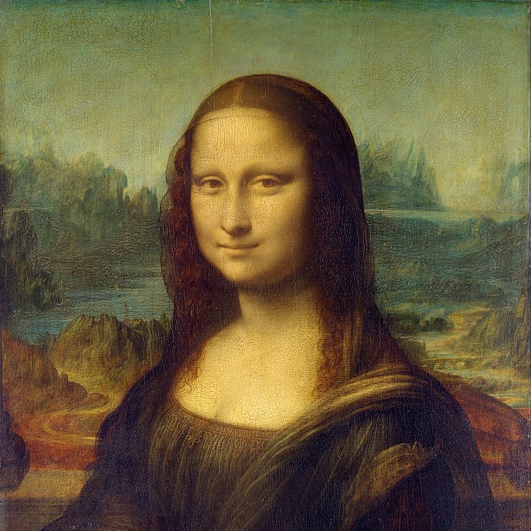
Spatial Parallel Training
The general idea is to break the input into smaller pieces and distribute the work among different processors
Need to exchange boundary points for spatial convolutions
64 px
64 + 1 + 1 px
GPU1
GPU2
GPU1
GPU2
GPU3
GPU4
GPU3
GPU4
Peter Jin, Boris Ginsburg, and Kurt Keutzer. "Spatially Parallel Convolutions" ICLR Workshop Track, 2018
Notes:
\begin{align*}
T_{{comm}}({domain}) = &\sum_{i=1}^{L}\left(\alpha + \beta B X^i_WX^i_C{k^i_h/2}\right)\\
+ &\sum_{i=1}^{L}\left(\alpha + \beta B Y^i_WY^i_C{k^i_w/2}\right)\\
+2&\sum_{i=1}^{L}\left(\alpha {\log(P)}+ \beta \frac{P-1}{P} |W_i|\right)
\end{align*}
\begin{align*}
T_{{comm}}({domain}) = &\sum_{i=1}^{L}\left(\beta B X^i_WX^i_C{k^i_h/2}\right)\\
+ &\sum_{i=1}^{L}\left(\beta B Y^i_WY^i_C{k^i_w/2}\right)\\
+2&\sum_{i=1}^{L}\left(\beta \frac{P-1}{P} |W_i|\right)
\end{align*}

Slide 46
Communication Complexity
64 + 1 + 1 px
Exchanging horizontal pixels
Exchanging vertical pixels
All reduce Cost
(same as before)
GPU1
GPU2
GPU3
GPU4
Peter Jin, Boris Ginsburg, and Kurt Keutzer. "Spatially Parallel Convolutions" ICLR Workshop Track, 2018.
Gholami, Amir, Ariful Azad, Peter Jin, Kurt Keutzer, and Aydin Buluc. "Integrated model, batch, and domain parallelism in training neural networks." SPAA, 2018.

Slide 47
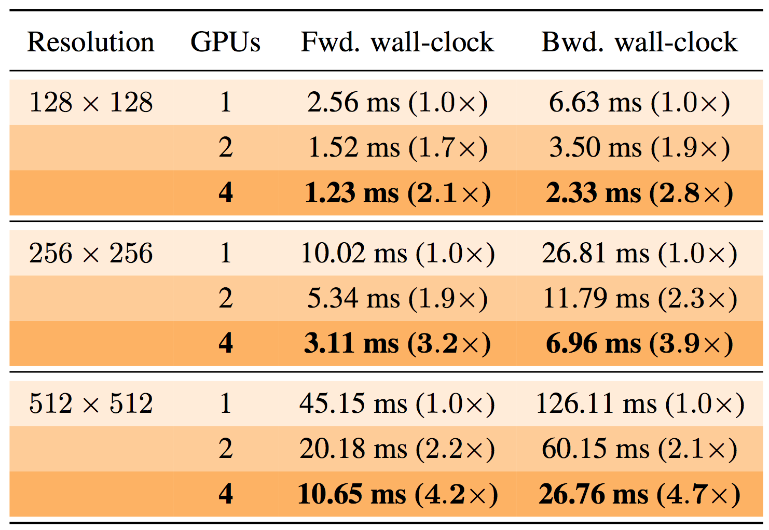

Useful for High Resolution Training
Domain parallel scaling on V100 GPUs
3x3 Conv, Batch=32, Channel=64
Peter Jin, Boris Ginsburg, and Kurt Keutzer. "Spatially Parallel Convolutions" ICLR Workshop Track, 2018
Figure from: Dumoulin, V., Visin, F.. A guide to convolution arithmetic for deep learning. arXiv:1603.07285, 2016.

Slide 48
Spatial Parallelism Summary
A little harder to implement since you need to exchange the boundary points
Only effective for high resolution input data
Limits the number of processors that can be effectively utilized
GPU1
GPU2
GPU3
GPU4

